Slide 1
C++ Programming Today 2nd Edition By Barbara Johnston Chapter 6
Instructor: <Instructor Name>
Lecture Slides by Kelly Montoya and Rob Garner

Slide 2
Chapter 6
Array Fundamentals
Loops and Arrays
Array Declaration and Initialization
Array Out of Bounds
Vectors and Arrays
Arrays and Functions
Example using Arrays and Functions
Character Arrays
Character Array Initialization
The Null Character
Character Array
Data Structures
Filling Arrays from Data Files
The ifstream and ofstream Classes
Using Char Delimiters with GetLine
Parsing Strings
Converting Strings to Numbers
Multi-dimensional Arrays
Two-Dimensional Array Initialization
Nested for Loops and Two-Dimensional Arrays
Multi-dimensional Arrays and Functions
Common Errors With Arrays

Slide 3

Filling Arrays from Data Files
Describe process for filling arrays from data files.

Slide 4
Filling Arrays from Data Files
In real programs, data are usually read from a data file (or files), or obtained from a database.
Four simple steps are required:
The program needs to be told where the data file is located.
It needs to open the file.
Once open, the data can be read from the file.
Close the file when finished reading the data.

Slide 5
The programmer must know exactly how the data is formatted in the data file.
The read statements must correspond to the way the data is formatted in the file.
Appendix F, “File Input/ Output,” contains more examples for reading textual and binary data as well as writing data to an output file.

Slide 6
The ifstream and ofstream Classes
Explain how to use the ifstream and ofstream classes to read and write data to files.

Slide 7
The ifstream and ofstream Classes
The class ifstream contains the necessary functions for opening and reading data from files.
The class ofstream contains the functions for writing data to a file.
Because they are stream classes, many of they things we do when using cout or cin apply directly to our ifstream and ofstream objects.
See http://www.cplusplus.com/reference/fstream/
Notes:
Program 6-14 revisits the phone bills program using ifstream and ofstream objects, also broken up into 3 files.

Slide 8
The ifstream and ofstream Classes
The PhoneBills program with data files.
We will read data and write results.

Slide 9

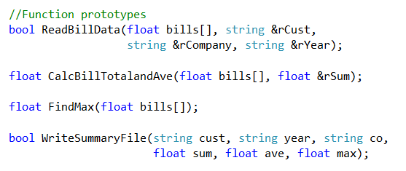
Top of file in PhoneFunctions.CPP
Prototypes in Functions.H
These are the prototypes for the data file functions.

Slide 10
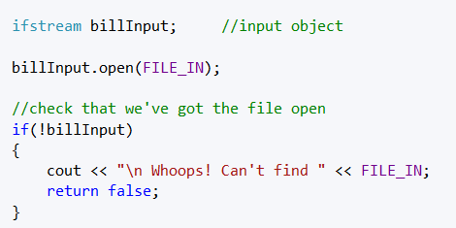
When we open the input file, we check to be sure we found it. If we didn’t find it, we issue an error message and return false (no file) to main.
Code from ReadBillData function:
the input stream object
FILE_IN is defined to be “PhoneBills.txt”
check that we've got the file open
This is where we create the input object and open the data file.

Slide 11
The ifstream and ofstream Classes
If there are any problems finding or opening the file, the program writes the “Whoops” message and returns a false.
No problems, then, we are ready to start reading.
We use the billInput object just as we would the cin object.
We read the first three lines to obtain the company, customer and year data.

Slide 12
The ifstream and ofstream Classes
We then use a for loop to read the ball values.
The output file is the same idea.
We make an ofstream object, open it, check that it was opened without problems, then write data to the file.
More code next.

Slide 13
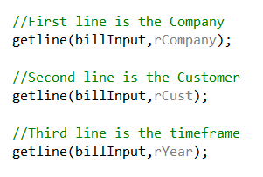
Read monthly bill info using ifstream object
getline and cin works just like it did for keyboard input--except use ifstream object
This is one way to read the data from the file – line by line.

Slide 14
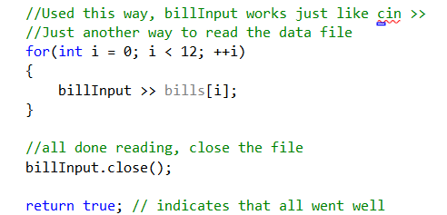
The ifstream and ofstream Classes
At this point, all data is read into the program from the input file defined at the beginning of the file.
After calculations are performed, we write the output file, shown next.

Slide 15
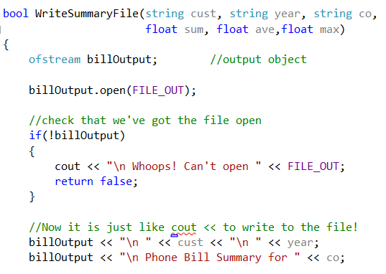
Create the output object and check that the file opened correctly.

Slide 16
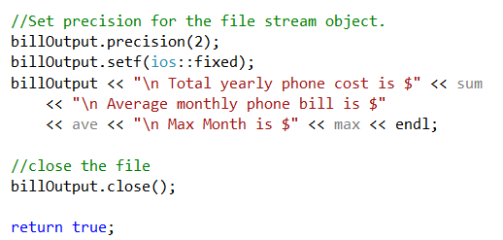
The ifstream and ofstream Classes
All data is now written to the file “PhoneBillSummary.txt” defined at the beginning of the file.

Slide 17
Chapter 6
Array Fundamentals
Loops and Arrays
Array Declaration and Initialization
Array Out of Bounds
Vectors and Arrays
Arrays and Functions
Example using Arrays and Functions
Character Arrays
Character Array Initialization
The Null Character
Character Array
Data Structures
Filling Arrays from Data Files
The ifstream and ofstream Classes
Using Char Delimiters with GetLine
Parsing Strings
Converting Strings to Numbers
Multi-dimensional Arrays
Two-Dimensional Array Initialization
Nested for Loops and Two-Dimensional Arrays
Multi-dimensional Arrays and Functions
Common Errors With Arrays

